Slide 1

Virtual Pizza Lunch with interesting persons
Aparna, chidi and brian

Slide 2
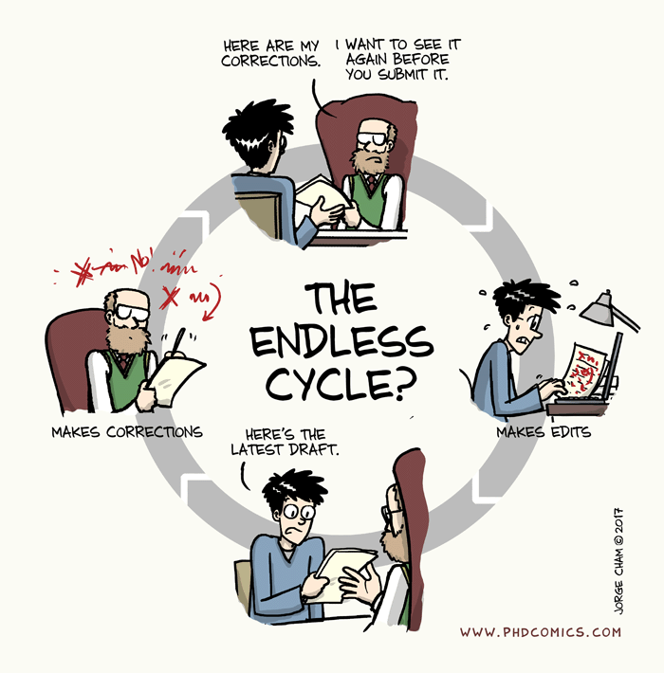

Slide 3
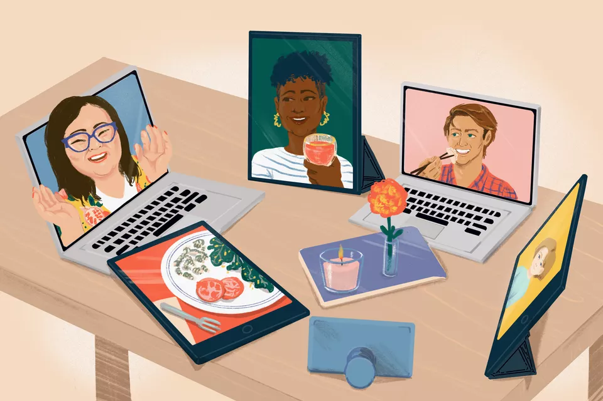
Motivation

Slide 4
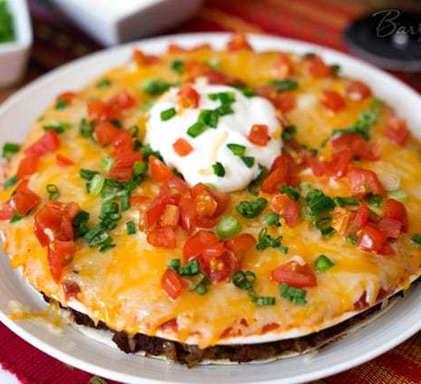
Methodology
- Check the establishments for hygiene
- Taste testing
- Recommendation
- Conduct a survey
- Get feedback

Slide 5
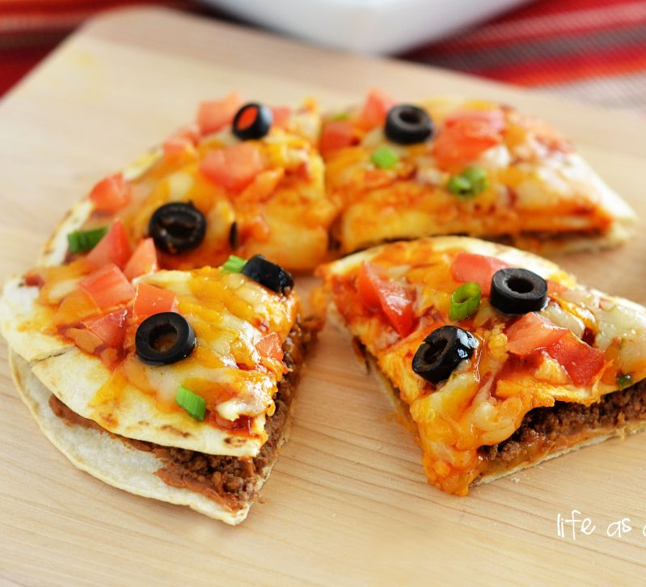
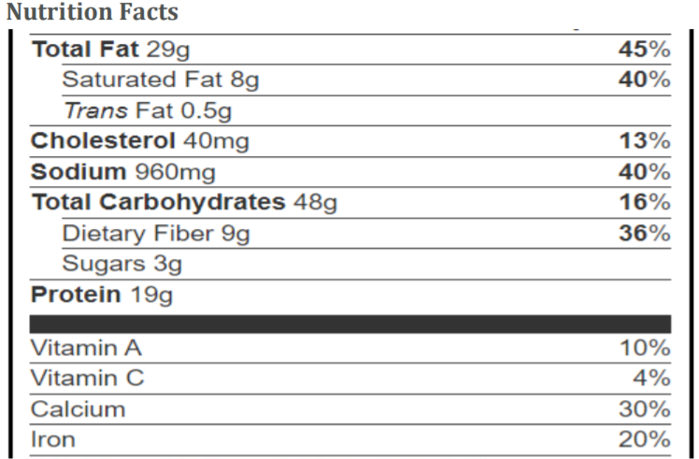
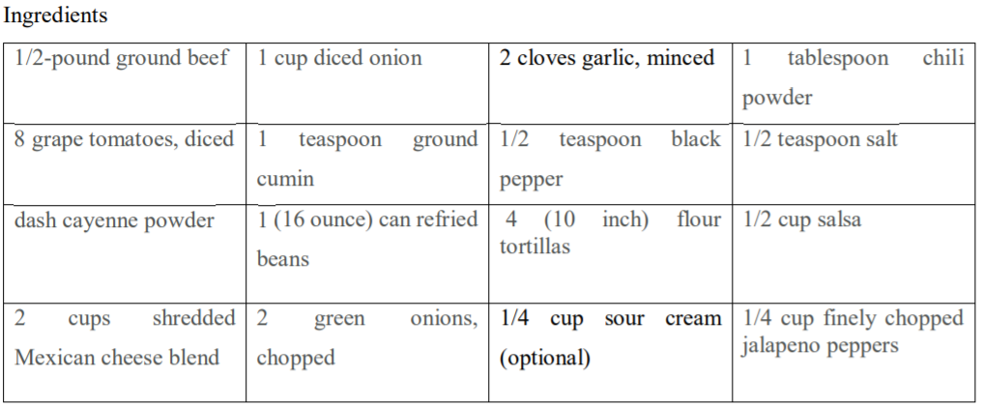
Why we chose Mexican pizza

Slide 6

Budget
$30 + $50

Slide 7
Conclusion

